Slide 1
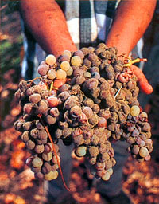
Crafting Fine Wines in a Challenging Year
Or... What’s your best bet when Mother Nature deals you a challenging hand at harvest?
Presented by Corrie Krehbiel with the support of Cellar-Tek Supplies & WIGA

Slide 2
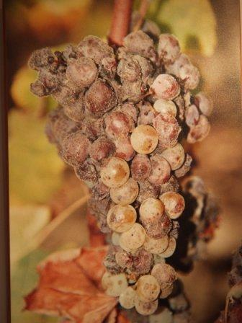
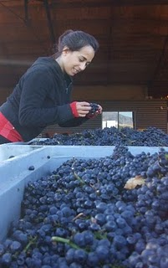
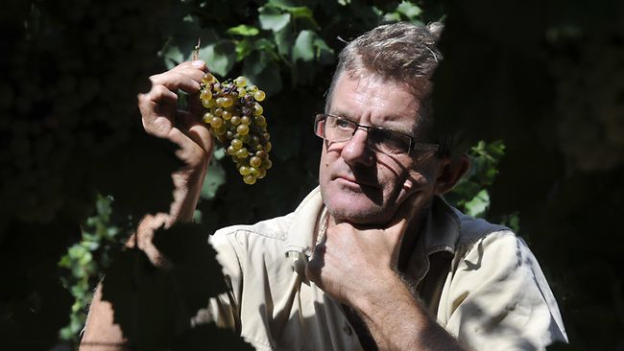
Seminar Outline
Strategies to Ensure a Successful Fermentation in Difficult Environments
Techniques to Reduce Green Characters
Processing Grapes with Botrytis and Rot
Methods for Enhancing Mouthfeel and Achieving Wine Balance

Slide 3
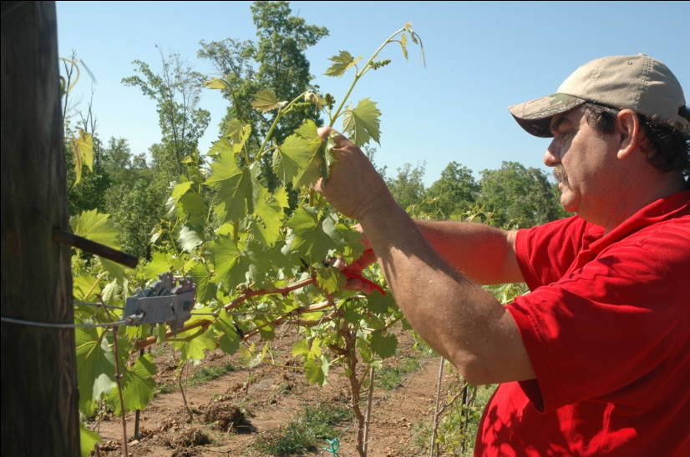
Successful Fermentation Strategies
In the Vineyard
Fruit Maturity
pH, TA, Brix
Flavour Development
Phenolic Ripeness
Disease Pressures
Sampling Procedure
At Harvest
Trained crews
Rapid Pick to Processing Times

Slide 4
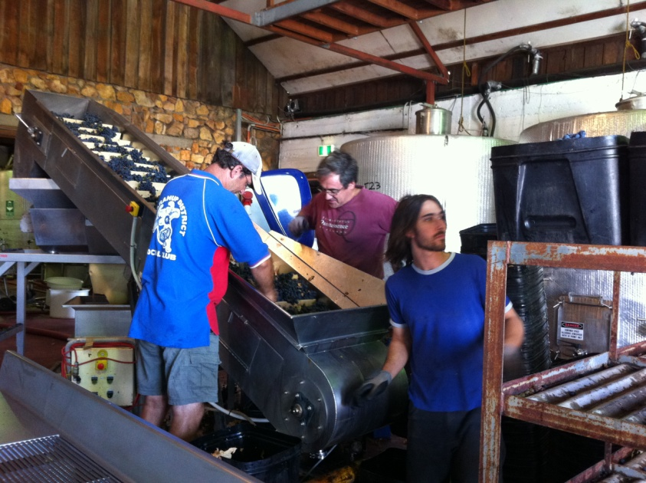
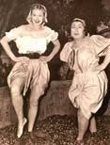
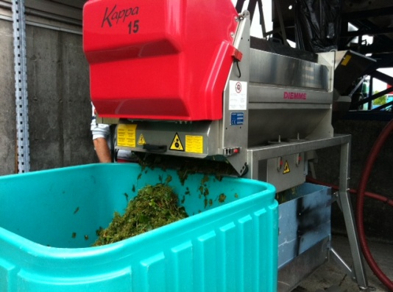
Successful Fermentation Strategies
Processing Considerations
Sorting
Crushed or Whole Cluster?
Crushed Fruit:
Advantages:
Less press space required
Increased yield
Disadvantages:
Increased solid content
Increased harsh phenolics

Slide 5
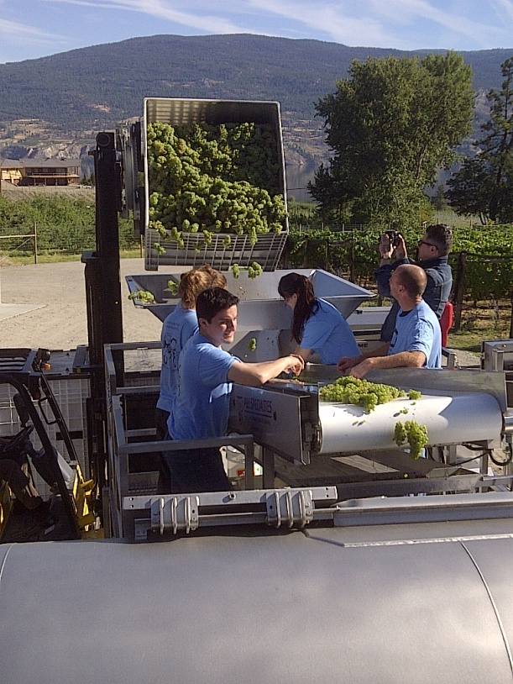
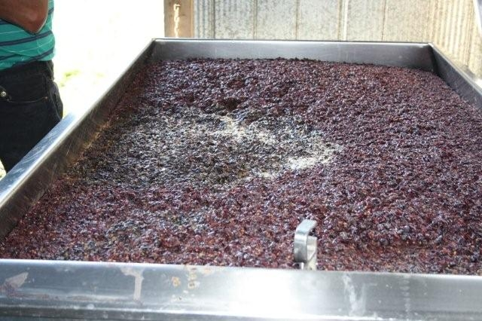
Processing Considerations
Whole Cluster
Advantages:
Fewer Solids
Less Sensitive to Oxidation
Fewer Harsh Phenolics
Disadvantages:
Smaller press loads,
i.e. “Takes more time”
Maceration Time

Slide 6
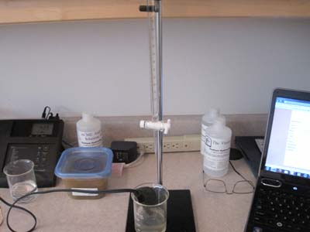
Pre-fermentation Analysis
Why do I need to analyze my juice?
Components to analyze:
pH, TA, Brix, YAN
Why Measure YAN?
To determine the amount of nitrogen that is needed to ensure a successful fermentation.
Note: if the YAN is <140 mg/L, it will also be lacking in lipids; therefore, yeast enhancers (Dynastart/Fermoplus Energy Glu) are necessary.

Slide 7
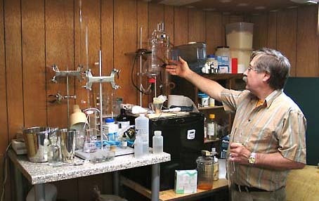
How to Measure Assimilable Nitrogen
Take 50mL of Clarified Must
Adjust the solution to pH 8.5 with 1N NaOH
Add 20mL Formaldehyde
Wait 2-3 Minutes.
Titrate with 0.1N NaOH until the pH is back to 8.5 (The number of ml needed is “n”)
YAN (mg/L) = n x 28

Slide 8
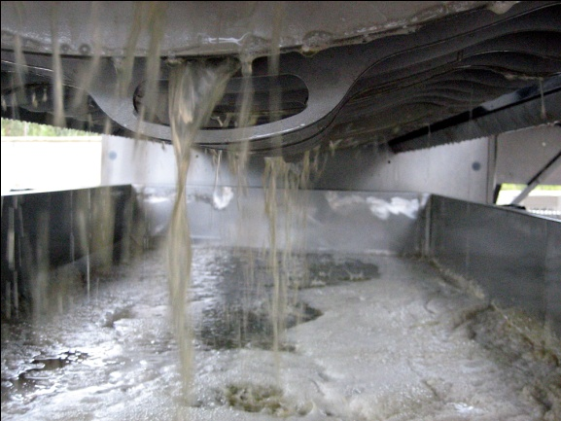
Juice Additions And Adjustments
SO2
Used to protect the juice from oxidation
Prevents the multiplication of spoilage organisms
Enzymes
In the grape and juice stage, pectolytic enzymes are used
Functions:
Increases free run yield
Improves settling
Temperature is Important!!
Consider your variety
Note: Pectolytic enzymes with B-glucosidase activities may be used later. Glucanases may be used later with grapes with rot.

Slide 9
Juice Additions and Adjustments
De-acidification
Potassium Carbonate or Potassium Bicarbonate
PPT of Potassium Bitartrate
Decrease of 1g/L requires
0.9g/L Potassium Bicarbonate
0.62g/L Potassium Carbonate
Potassium bicarbonate easily precipitates by chilling
Example: Deacid
Calcium Carbonate
PPT of Calcium Tartrate
Decrease of 1g/L requires 0.45 g/L Calcium Carbonate
Chilling has little effect on ppt of calcium tartrate

Slide 10
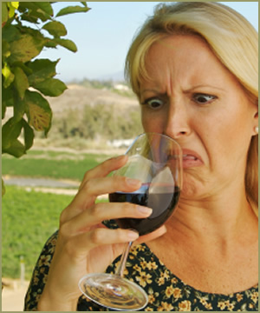
Juice Additions and Adjustments
Double Salt
Acidex
A preparation of calcium carbonate which also contains double salt crystals
Method
Only a portion is de-acidified
The Calcium carbonate present raises the pH above 4.5
pH is essential to dissociate the tartaric and malic forms sufficiently
At pH > 4.5 the malate and tartrate combine rapidly to form the double salt
Got Sour wine?

Slide 11
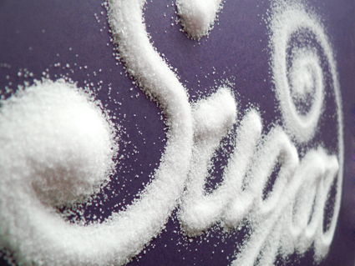
Juice Additions and Adjustments
Chapitalization
The addition of sugar with the intent to raise the concentration of alcohol
Conversion Ratio:
To increase alcohol 1%, 17 g/L of sugar is required
In reds, often 20 g/L is required
Ensure that the sugar is dissolved
Ensure that the sugar is added at the beginning of fermentation when the wine is not depleted of nutrients

Slide 12
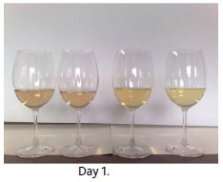
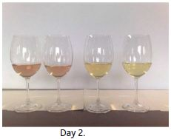
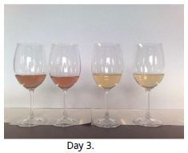
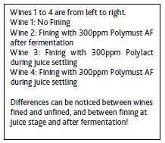
Juice Additions and Adjustments
Juice Fining
Why Juice Fine?
Reduction of bentonite need later
Removal of “pinking”
Oxidative protection
Aromatic precursor protection
Retention of fresh, fruit characters
Reduction of rot odours
Clarification
Risks
Over-fining
Juice that is too clear
Juice fining agents
Bentonites, Gelatins, Mixed agent blends
Notes:
Insert South African Juice fining Picture

Slide 13
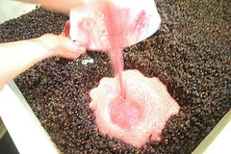
Steps to Achieving a Successful Fermentation
Selection of the Yeast Strain
Know your factors:
Grape Condition and Analysis
Your goal (stylistic objective)
Cellar restraints
(Tasting Of Pinot Gris Yeasts)
Timing of Inoculation
Inoculate as soon as possible to avoid multiplication of indigenous flora and nutrient reduction.

Slide 14
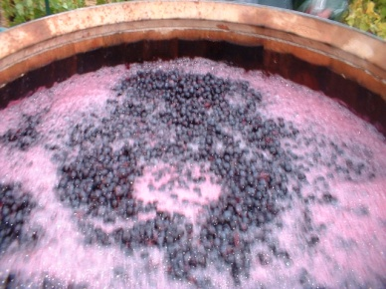
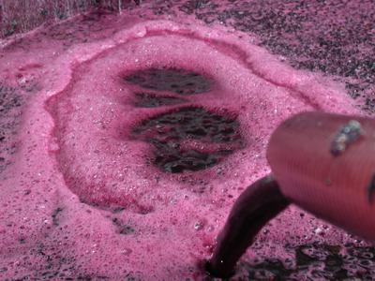
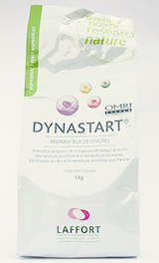
Steps to a Successful Fermentation
Rehydration Method
Use a Clean Container
Add Chlorine Free Water at 37°C to the Container (10x the weight of the yeast)
Add a Yeast Rehydration Nutrient (Dynastart, Fermoplus Energy Glu) Why?
Improved Aromatics
Improved Temperature Tolerance
Improved Alcohol Tolerance
Improved Cell Viability at the End of Fermentation

Slide 15
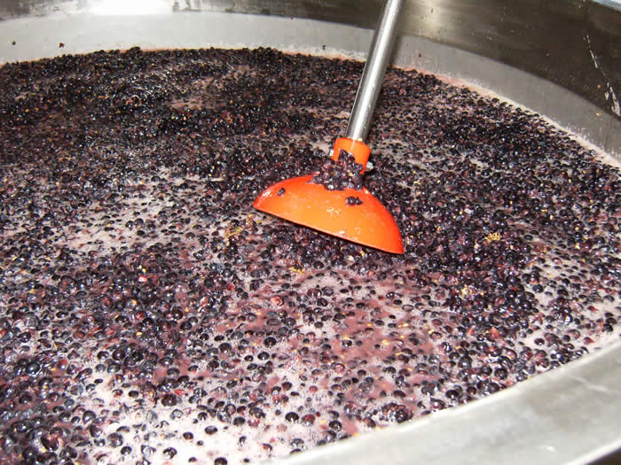
Steps to A Successful Fermentation
Add 20-25 g/hL of yeast
Let sit for 20 minutes
CHECK THE TEMPERATURE DIFFERENCE BEFORE ADDITION – MUST NOT BE GREATER THAN 10 C
Other Keys:
Temperature at beginning and end of AF
Aeration and turbidity

Slide 16
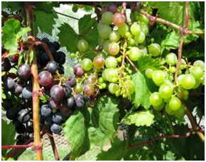
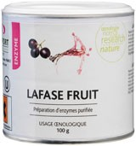
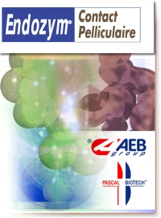
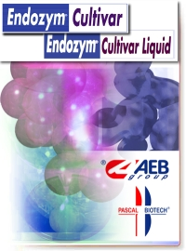
Treating Under Ripe Grapes
Considerations when Treating Unripe Grapes
Limited Extractability
Unripe Grape and Seed Tannins
Green Characters
Limited Extractability
Due to thicker skins
Enzyme Use: Lafase Fruit, Contact Pelliculaire, Endozym Cultivar
Protect your skin tannins!!

Slide 17
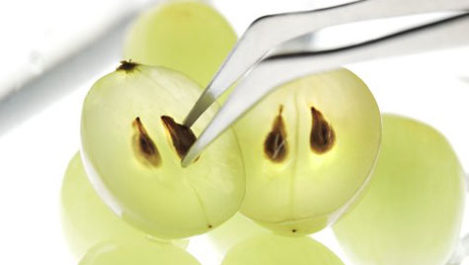
Treating Unripe Grapes
Addressing Unripe Seed Tannins
De-seed
Limit Maceration time (especially extended)
Ensure colour stabilization
Dealing with Green Character
Yeast Choice (Pinot Noir Tasting)
Untoasted Oak in Fermentation
Aging Tannins and Mannoproteins

Slide 18
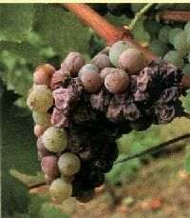
Treating Grapes with Rot and Botrytis
Botrytis Cinerea
Mycelium fungus – aka grey mould
Develops on the grapes and forms small grey-white filaments
Why is Botrytis a problem?
Laccase production
LACCASES = OXIDATION + BROWNING
Glucanases
GLUCANASES = PLUGGED FILTERS
Mouldy/Compost aromas
Fermentation issues due to toxins produced by botrytis

Slide 19
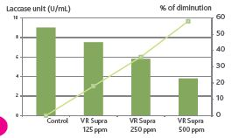
Treating Grapes with Rot and Botrytis
How to combat rot and botrytis
Add Tannins Early
Protects colour
Inhibits laccases
Provides oxidative protection
Improves structure of the finished wine
Use Enzymes
β- 1,3 and 1,6 glucanases degrade the glucans (and improve filterability)
Add Mid-way through fermentation
Examples: Extralyse, Endozym Antibotrytis

Slide 20
Treating Grapes with Rot and Botrytis
Reduce or Eliminate Maceration Time!
Choose Yeast Wisely!
Short Lag Phase
Strong Fermentation Kinetics
OXIDATION

Slide 21
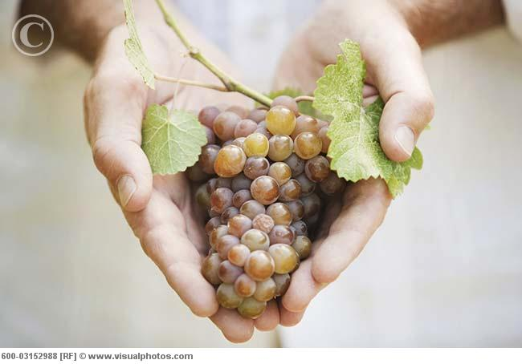
Treating Grapes with Rot and Botrytis
Handle Gently
Pre-fermentation
During Fermentation
Examples.......

Slide 22
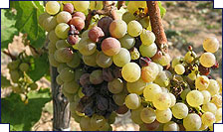
Botrysized White Wine Production
Sort Grapes
In the field
Pre-processing
De-stem and Crush Gently (or whole cluster).
Add Pectinase (Endozym ICS 10 Eclair, Endozym Cultivar, Lafazym CL)
Add Gallic Tannin
5 g/hL (up to 10 – 12 g/hL depending on grape quality)
Galalcool, Gallovin

Slide 23
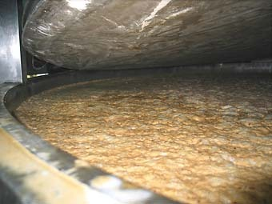
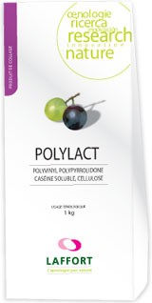
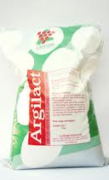
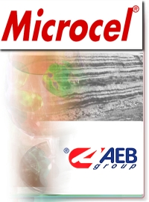
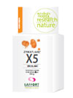
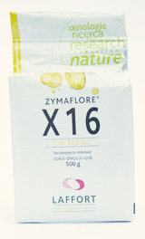
Botrysized White Wine Production
Fine the juice
Examples:
Polylact (PVPP-casein) and bentonite
Argilact (Casein and bentonite)
Microcel (Casein and bentonite)
Biocatalasi
Inoculate
With Strong Culture / Short Lag Phase
X5, X16, Fermol Arome Plus
Use rehydration nutrients and ensure adequate juice nutrition

Slide 24
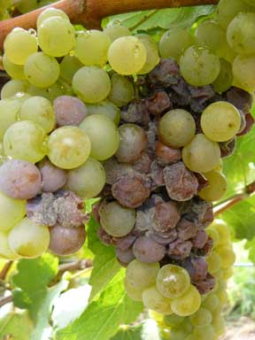
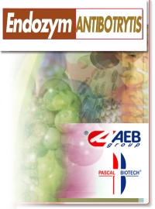
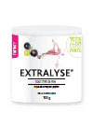
Botrysized White Wine Production
Ferment and Rack Anaerobically
Until laccases are destroyed
Add SO2 and rack early
Use glucanase mid-late fermentation
Endozym Antibotrytis, Extralyse

Slide 25
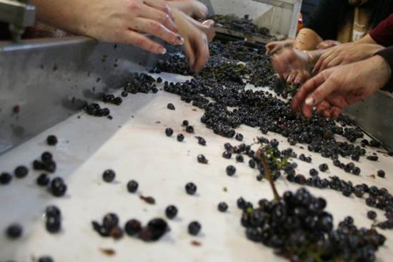
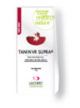
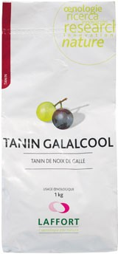
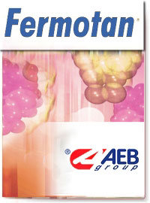
Botrysized Red Wine Production
Sort Grapes
In the field
Pre-processing
Destem and Crush Gently
Add 70-80 ppm of SO2 at the crusher
Add VR Supra or Fermotan as tank is being filled (30-70 g/hL).
Add 3-5 g/hL of Gallovin or Galalcool if rot pressure is extreme
Add enzyme for gentle extraction – Lafase fruit, Contact Pelliculaire

Slide 26
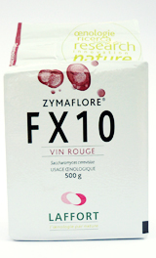
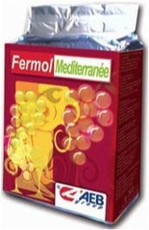
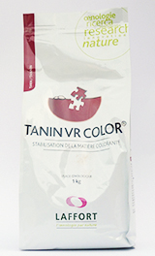
Botrysized Red Wine Production
Limit or Avoid Maceration
Inoculate
With Strong Culture / Short Lag Phase
FX10, Fermol Mediteranne
Use rehydration nutrients and ensure adequate juice nutrition
Consider VR Colour for Colour Stabilization
Limit Pumpovers/Punchdowns
Mid-ferment add B-glucanase
Press early

Slide 27
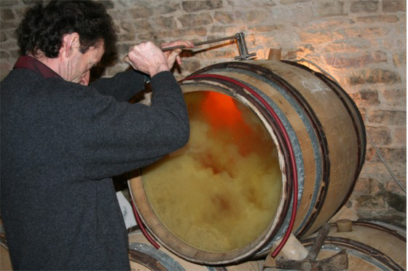
Enhancing Mouth Feel After Fermentation
Mannoproteins
Yeast Cell Wall
Mimic lees aging
Rounds out mid-palate and masks bitterness
Biolees MP, Battonage Elevage, Battonage Plus Structure

Slide 28
Enhancing Mouth Feel After Fermentation
Gum Arabic
Large polysaccharide gum
Introduced initially for tartrate stability
Viscous – gives perception of sweetness
Add Last!!
Stabivin, Arabinol

Slide 29
Enhancing Mouth Feel After Fermentation
Aging Tannins
Proanthocyanidinic (seeds & skins)
Build structure and fill in gaps
Ellagic (seasoned oak tannins)
Improve Structure and Aromatics

Slide 30
Thank-you.
I appreciate your time to attend this seminar and sincerely hope you were able to take away some useful information to help you make the best wines you can, even in a challenging harvest like the one that looks like it’s shaping up out there as we speak...
If you’d like to discuss anything from any of the slides further, don’t hesitate to contact me directly.
Corrie Krehbiel ckrehbiel@cellartek.com
250-878-5957

